Slide 1
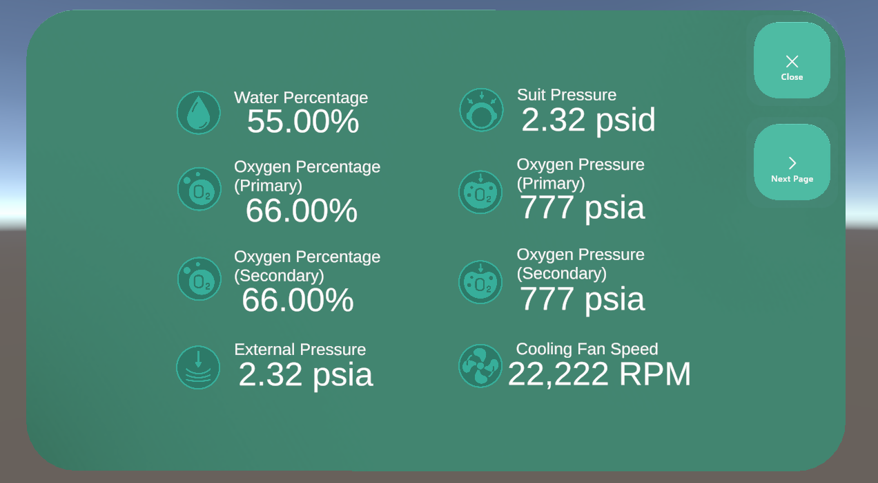
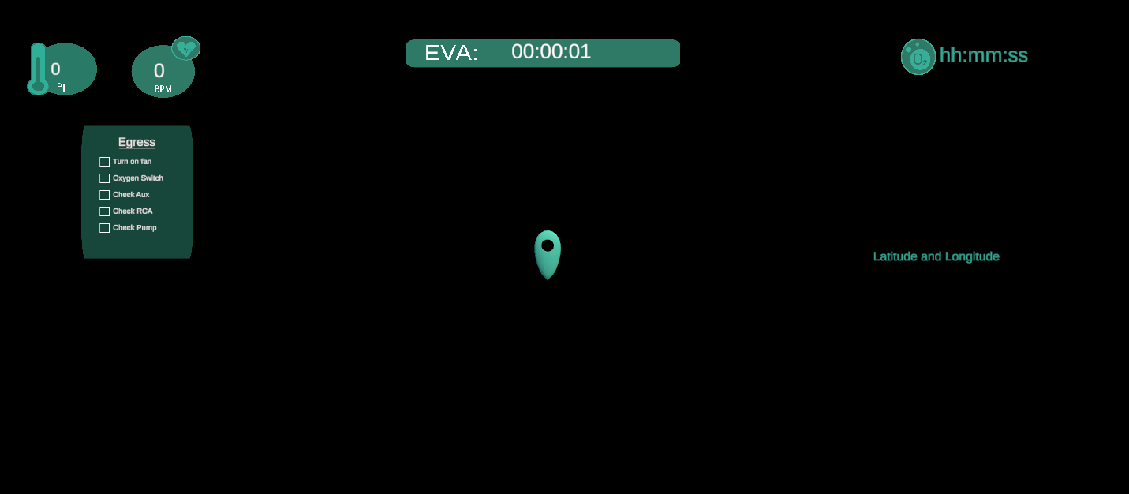
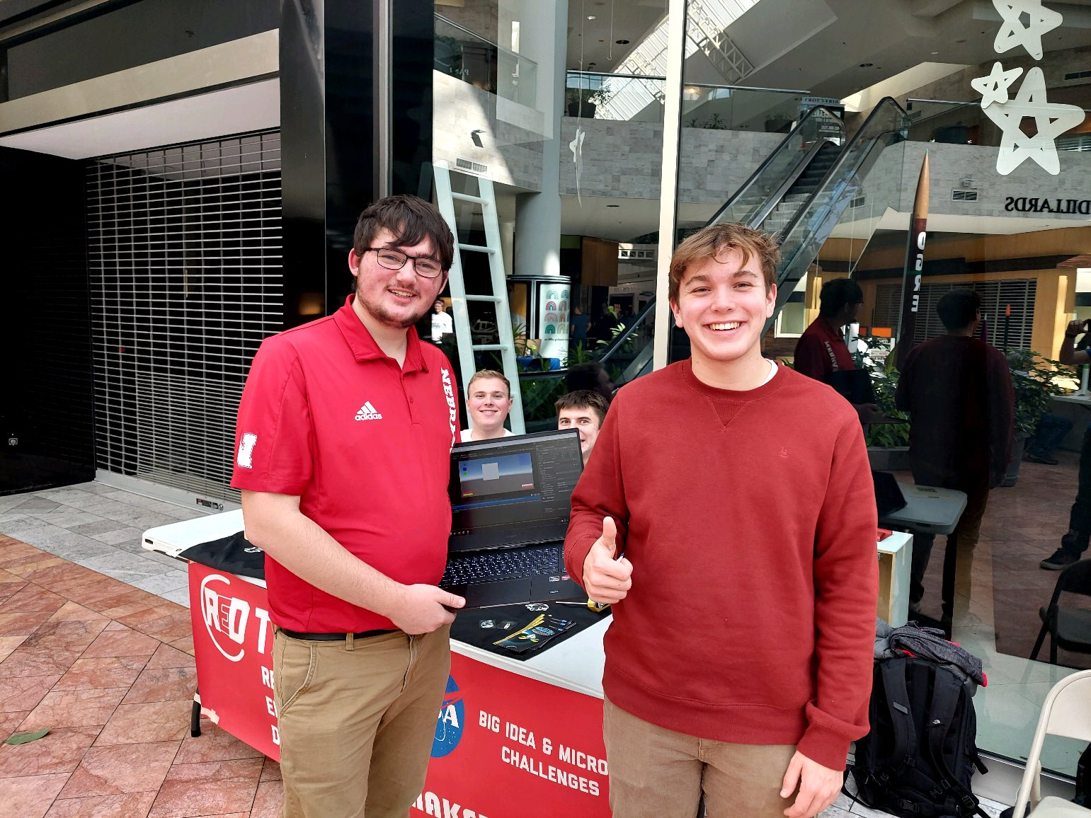
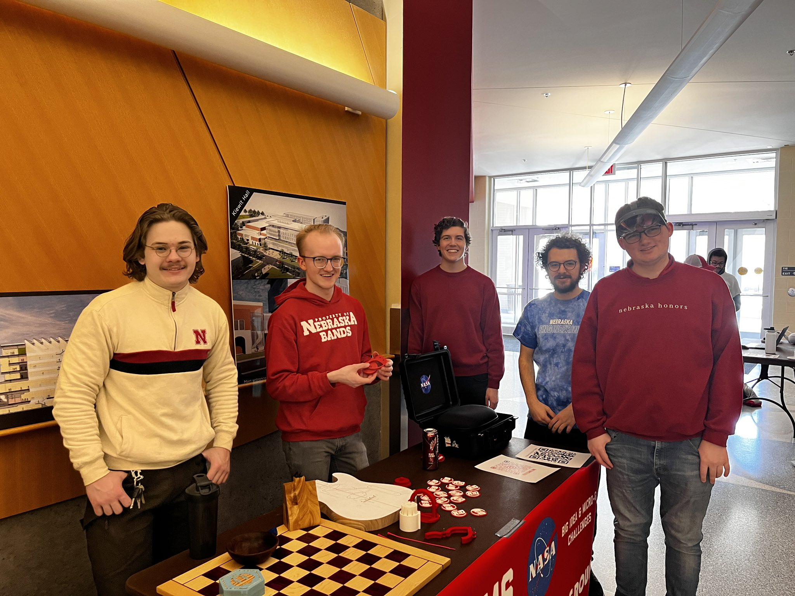
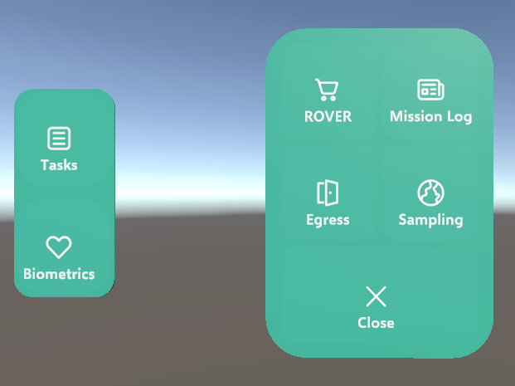
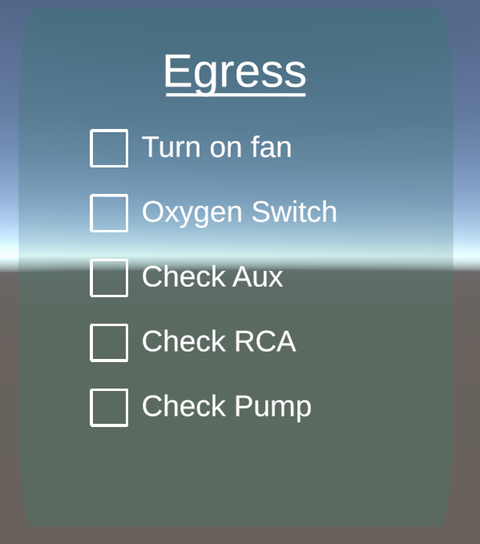
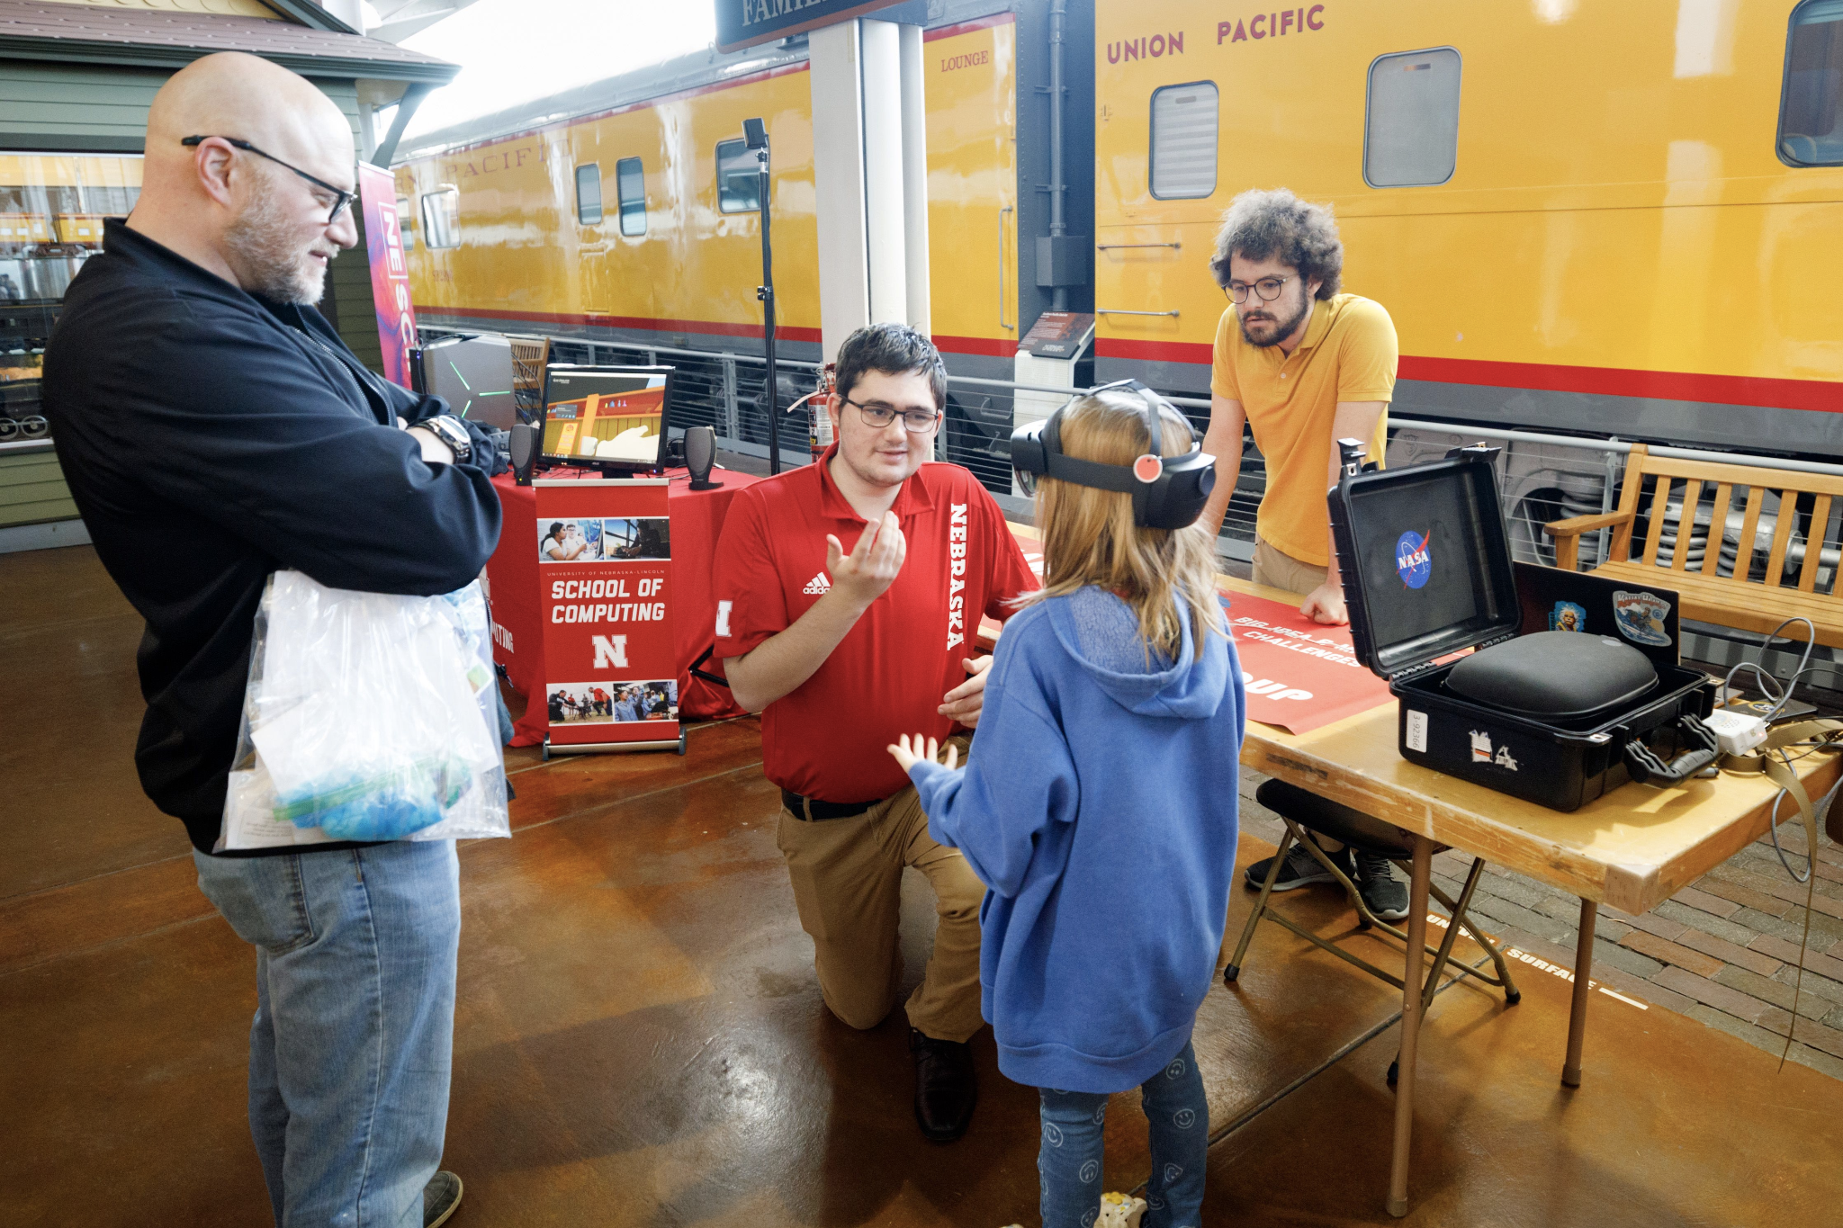
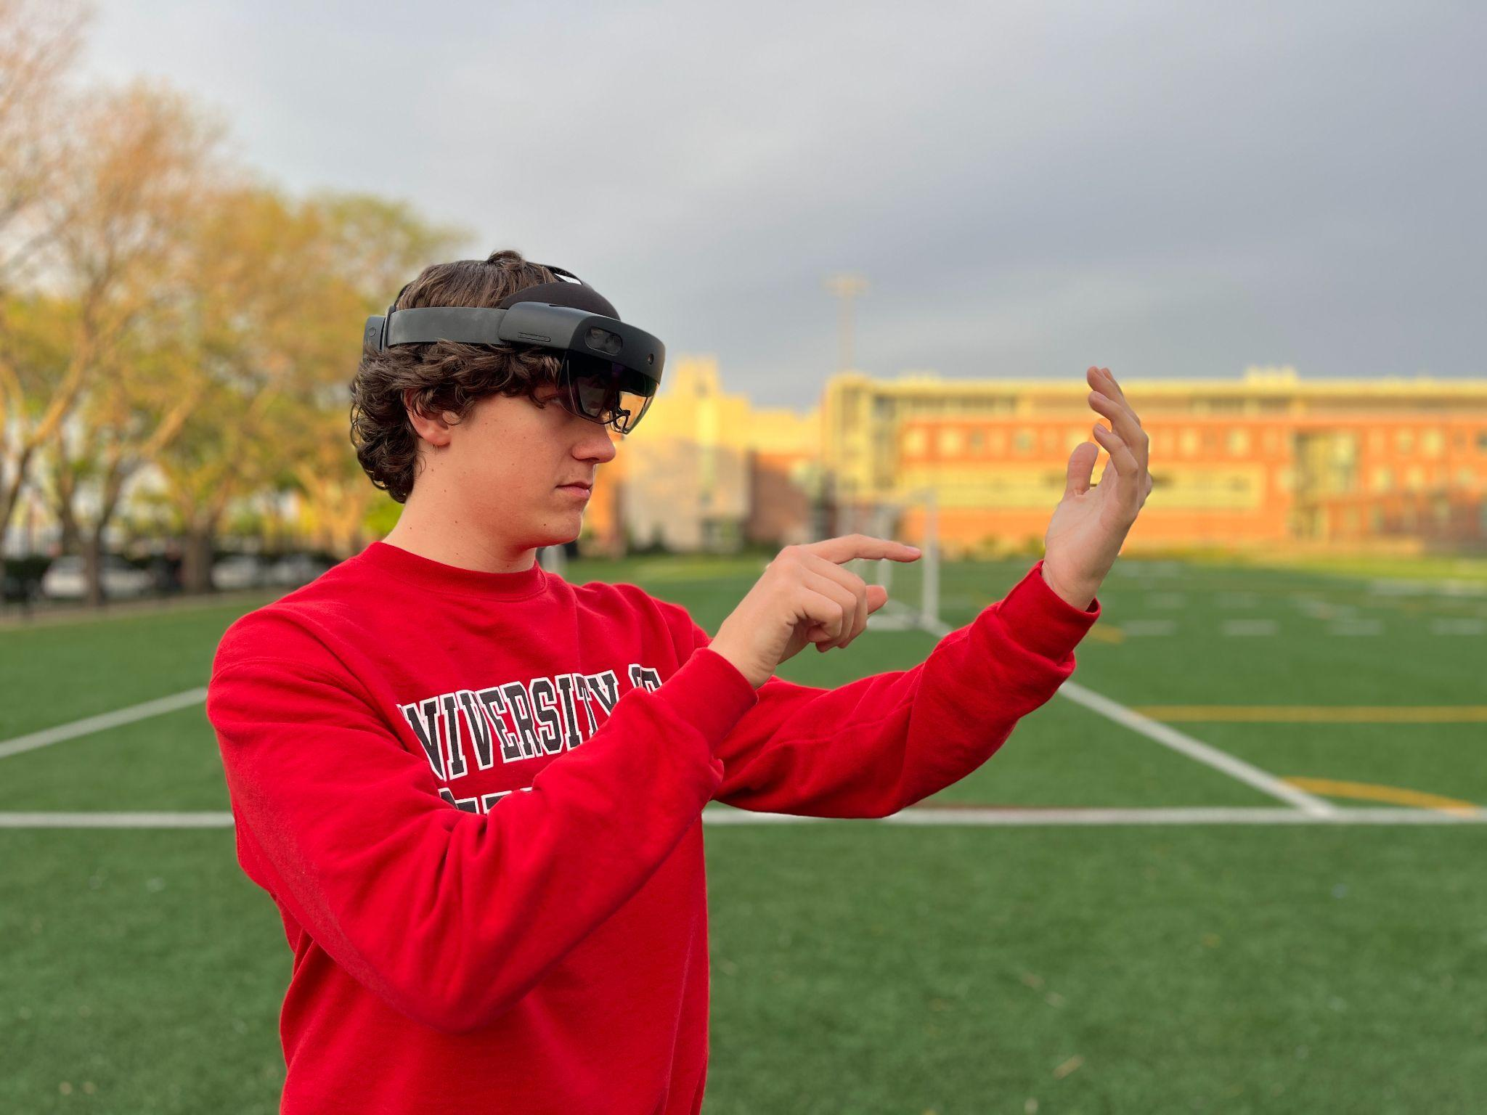
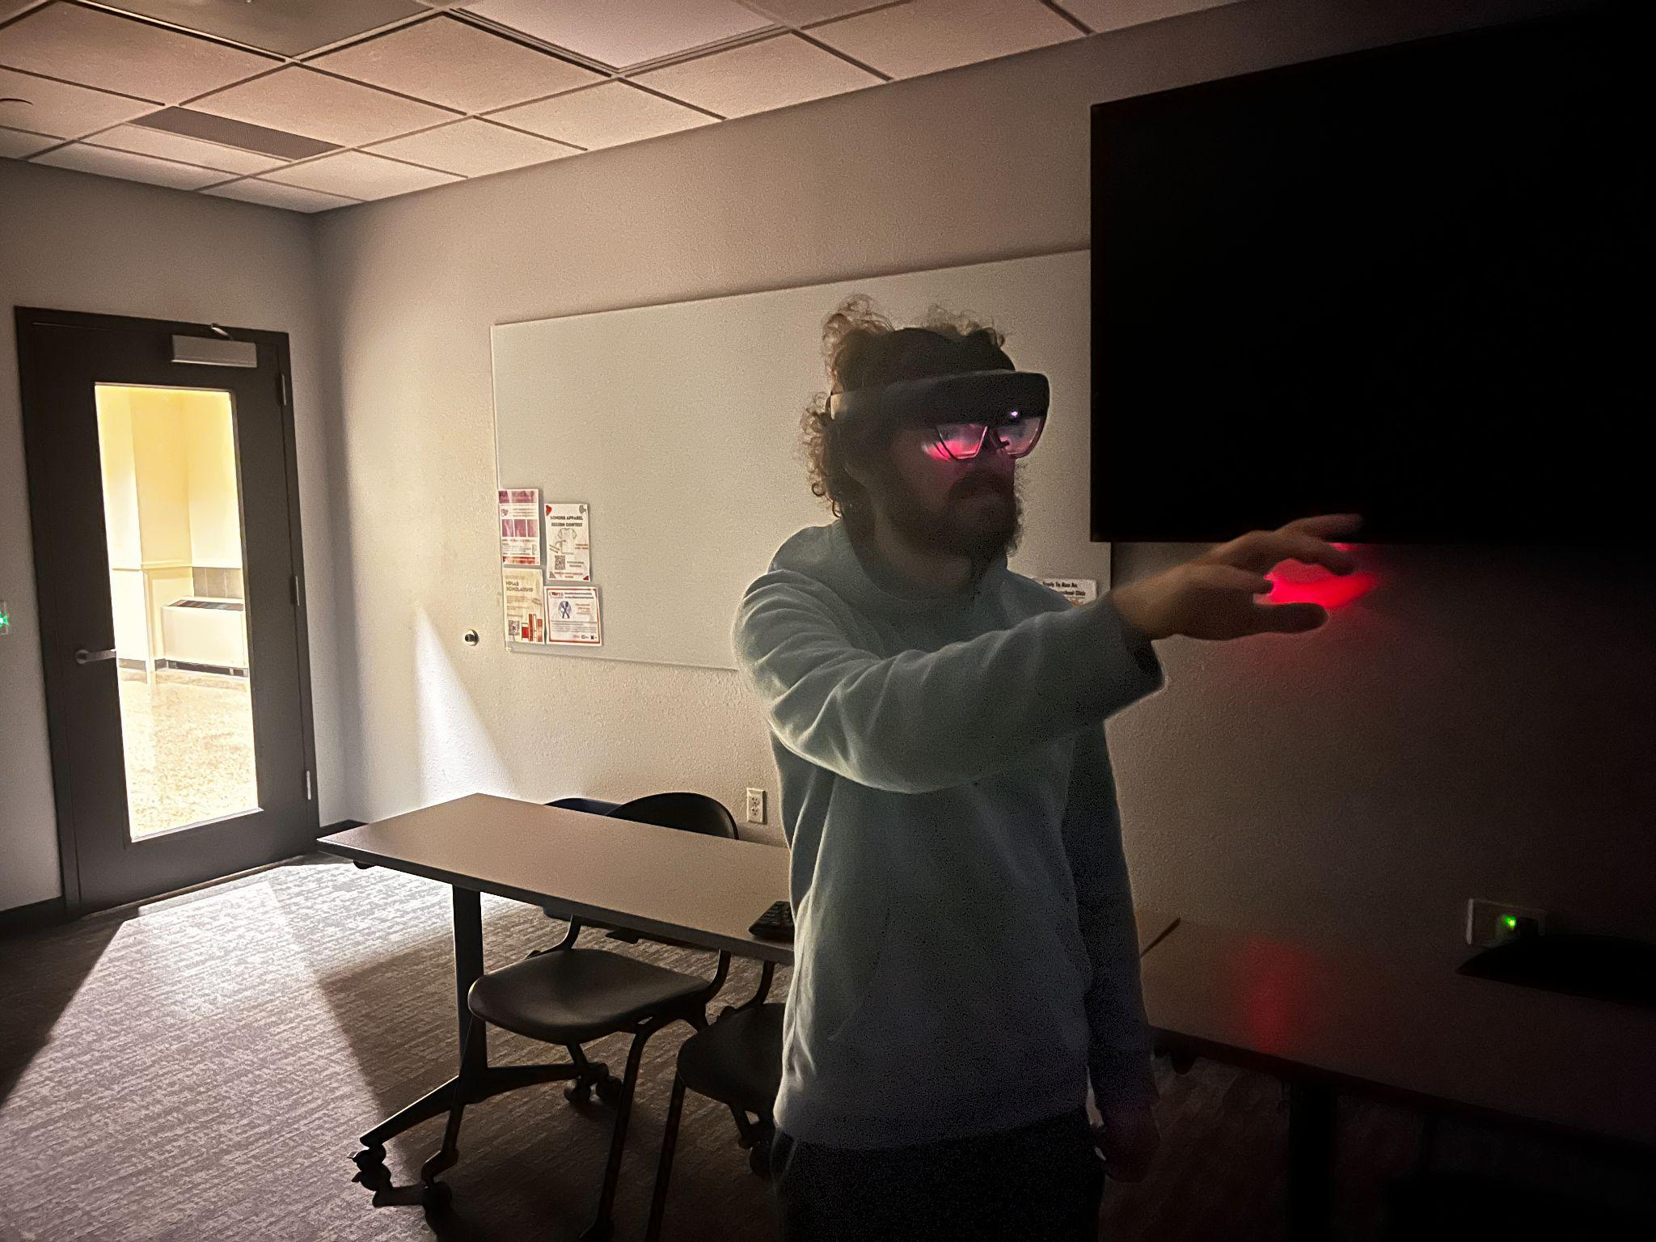
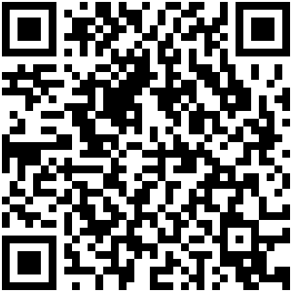
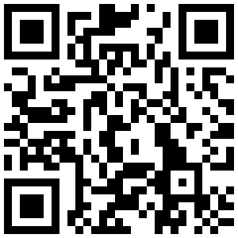




Multi Orientation Reality Tool and Interface (MORTI)
Matthew Bigge¹, Joseph Seibel¹, Peyton Comer¹, Michael Dejournett¹, Preston Ward², Elijah Schoneweis¹, Lindsey Johnson³, Chris A. Bourke¹
University of Nebraska-Lincoln, School of Computing¹, College of Engineering², Hixson Lied College of Fine and Performing Arts³
Project Management
Matthew Bigge, Point of Contact/Team Lead Joseph Seibel, TSS Developer Peyton Comer, UI Developer Preston Ward, UX Developer Michael Dejournett, Navigation Developer Charlie McIver, UX Developer Lindsey Johnson, UI/UX Graphic Design Elijah Schoneweis, Developer
Project Overview
User Interface The UI displays user information such as heart rate, temperature, location constantly When conducting EVA tasks, Task steps and information are displayed to the side
Educational Outreach
Aviation Stem Day at Oakview mall Hosted a NASA booth at a public STEM event Educated attendees of all ages about our project and NASA in general Nebraska Academy of Sciences Conference Presented research poster in the aeronautics and space science session New Student Enrollment Day Hosted a club booth at university enrollment day Educated new students about our club's projects and NASA in general Nebraska Science Festival Hosted a NASA booth at a public STEM event in Omaha, NE
Project Objectives
Project User Interface must: Device should work in harsh lighting (bright light, no light, low angle light, etc). and outdoor condition. The device must be able to access and display the telemetry stream data. A caution/warning system must be implemented to inform the astronaut about a spacesuit anomaly. The system shall assist the astronaut during navigation The system shall display necessary EVA task instructions The system design shall not distract the user or crowd their FOV with non-critical information
Figure 3: Bioinformatics Panel
Figure 2: UI in editor
Navigation
Pin system to mark notable locations(Home, Mission Areas, etc)
‘Breadcrumbs’ left automatically by system for easy return navigation
Figure 5: Aviation Stem Day Booth
Figure 6: New Student Enrollment Booth
Figure 3: Task Menu
Figure 4: Egress HUD Element
Github Repo
Club Twitter
EVA Tasks
Task submenu allows selection of basic EVA tasks
Once selected, task is begun with steps and information on the HUD
Figure 1: Photos of MORTI during on campus testing
Figure 7: Presenting AR project to Omaha students at NE Science Festival
Acknowledgements

